Slide 1
Welcome to our classroom.
Mrs. Hamill and Mrs. Moser

Slide 2
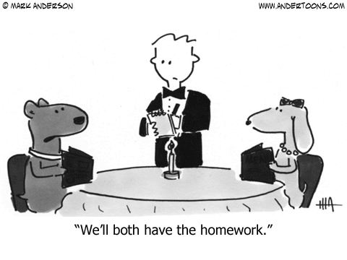
Homework

Slide 3
HOMEWORK
Math and Science homework is posted to Edmodo every Friday. (It will vary each week)
Homework will be due the following Friday.
Please practice multiplication facts.
A spelling list and worksheet will be given on Fridays. A spelling test will be given on the following Friday, and the worksheet will be due.
Other ELAR homework will be assigned occasionally. Usually a grammar focus sheet that will be passed out, as well as accessed through The Write Source online site.
It is expected for your child to be reading regularly. At least 90 minutes a week is recommended.

Slide 4
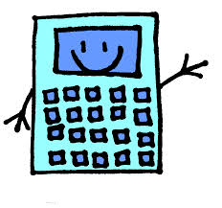
LEARNING TICKETS
Math Learning Ticket

Slide 5
LEARNING TICKETS
Reading Learning Ticket

Slide 6
Online Math Textbook
THINK CENTRAL

Slide 7
Edmodo
www.edmodo.com
Please have your child log on nightly.

Slide 8
Write-Source
Write Source

Slide 9
I Station
There’s an app for that!
In the Apple App store, search for istation.com.
Domain is wilmeth.mckinney.tx
Login is s###### (Your child’s student ID)
Password is ###### (Just their ID number- no “s”.

Slide 10
Remind 101
If you have not already signed up please text the following numbers and join both classes.
Text “@elar141” to (910) 778-5201 for Mrs. Hamill
Text “@68d14” to (610) 590 – 4907 for Mrs. Moser

Slide 11
Headphones
Please send in a pair of earbuds for your child. Ideally, they will fit in their pencil bags.

Slide 12
Report Cards
We have a 1, 2, 3, 4 system to show student mastery of skills.
1- Student does not have mastery at this time. Demonstrates a lack of understanding and an inability to complete grade level tasks.
2- Beginning to develop. Demonstrates initial understanding of skills. Applies skills, but requires teacher intervention and reinforcement due to lack of proficiency, or sufficient development.
3- Developed. Demonstrates proficient understanding and applies skills independently by the conclusion of the grading period.
4- Highly developed. Consistently demonstrates exemplary understanding and application of skills in a variety of complex situations; is working independently after initial instruction.

Slide 13
Parent/Teacher Conference Sign Up
October 27th—Monday
Watch for the Sign Up Genius link that will be emailed soon to sign up for a parent teacher conference.

Slide 14
Technology
Students are allowed to bring their own technology for class room activities. However, we can not be responsible for lost or stolen items.

